Slide 1

Exploratory Data Analysis and Building Supervised Machine Learning Models
Anshu Anamika

Slide 2
Mushroom Data Set
Collected from The Audubon Society Field Guide to North American Mushrooms.
Donated to the UCI Machine Learning repository in 1987.
Aim to build and evaluate classification models for predicting whether a mushroom is edible or poisonous based on its physical features.

Slide 3
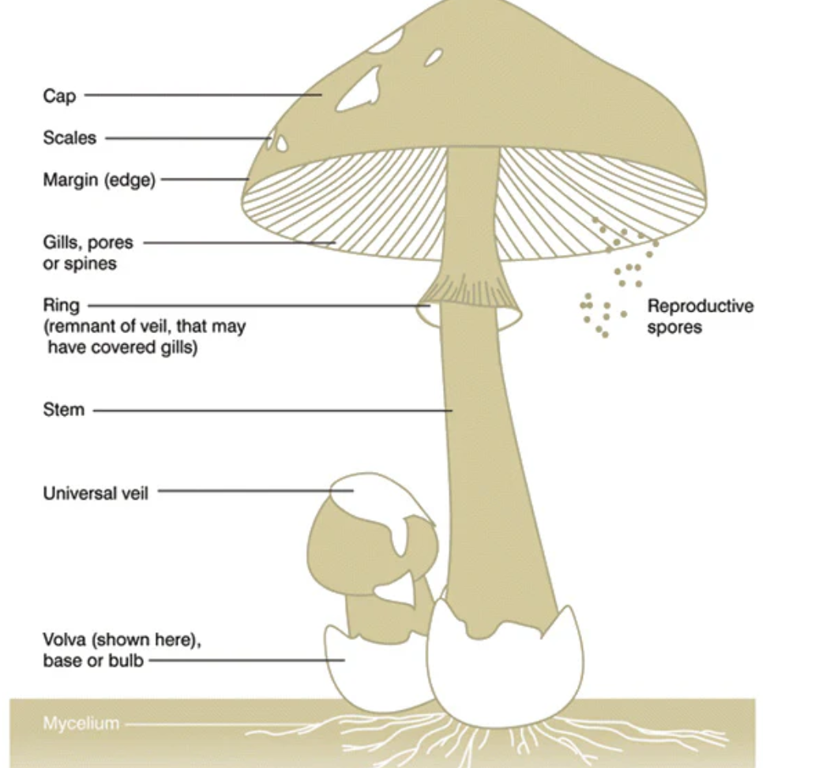
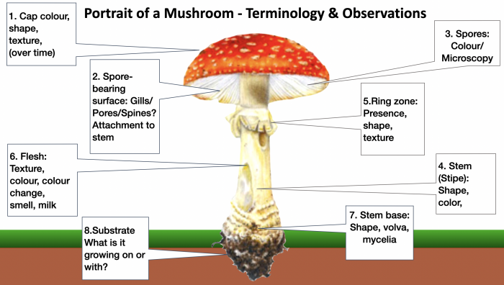
Mushroom Anatomy

Slide 4
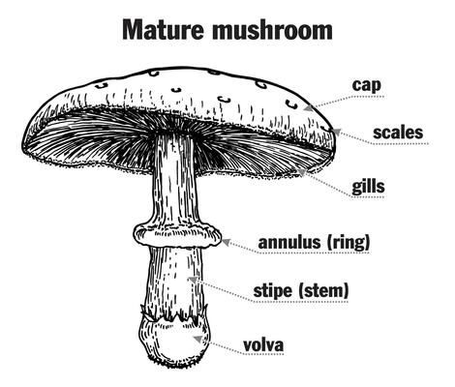
Data set (rows:8124, columns:23)
cap-shape: bell=b,conical=c,convex=x,flat=f, knobbed=k,sunken=s
cap-surface: fibrous=f,grooves=g,scaly=y,smooth=s
cap-color: brown=n,buff=b,cinnamon=c,gray=g,green=r,pink=p,purple=u,red=e,white=w,yellow=y
bruises: bruises=t,no=f
odor: almond=a,anise=l,creosote=c,fishy=y,foul=f,musty=m,none=n,pungent=p,spicy=s
gill-attachment: attached=a,descending=d,free=f,notched=n
gill-spacing: close=c,crowded=w,distant=d
gill-size: broad=b,narrow=n
gill-color: black=k,brown=n,buff=b,chocolate=h,gray=g, green=r,orange=o,pink=p,purple=u,red=e,white=w,yellow=y
stalk-shape: enlarging=e,tapering=t
stalk-root: bulbous=b,club=c,cup=u,equal=e,rhizomorphs=z,rooted=r,missing=?
stalk-surface-above-ring: fibrous=f,scaly=y,silky=k,smooth=s
stalk-surface-below-ring: fibrous=f,scaly=y,silky=k,smooth=s
stalk-color-above-ring: brown=n,buff=b,cinnamon=c,gray=g,orange=o,pink=p,red=e,white=w,yellow=y
stalk-color-below-ring: brown=n,buff=b,cinnamon=c,gray=g,orange=o,pink=p,red=e,white=w,yellow=y
veil-type: partial=p (universal=u)
veil-color: brown=n,orange=o,white=w,yellow=y
ring-number: none=n,one=o,two=t
ring-type: evanescent=e,flaring=f,large=l,none=n,pendant=p
spore-print-color: black=k,brown=n,buff=b,chocolate=h,green=r,orange=o,purple=u,white=w,yellow=y
population: abundant=a,clustered=c,numerous=n,scattered=s,several=v,solitary=y
habitat: grasses=g,leaves=l,meadows=m,paths=p,urban=u,waste=w,woods=d
classes: edible=e, poisonous=p

Slide 5
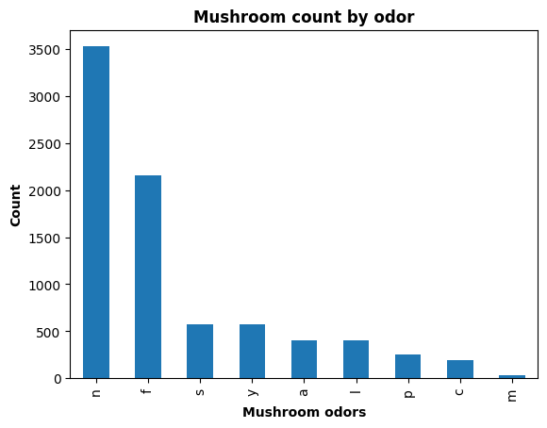
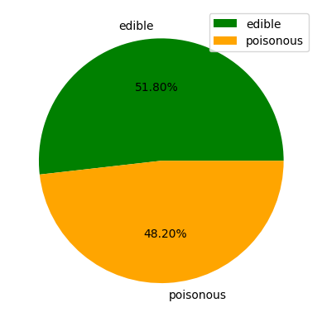
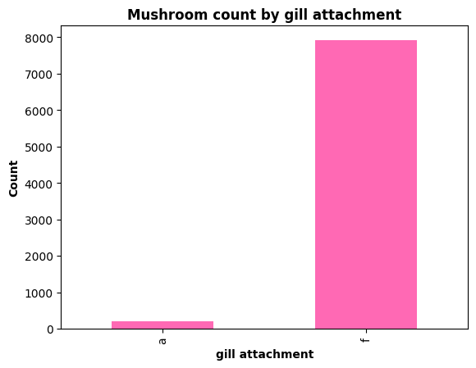

Slide 6
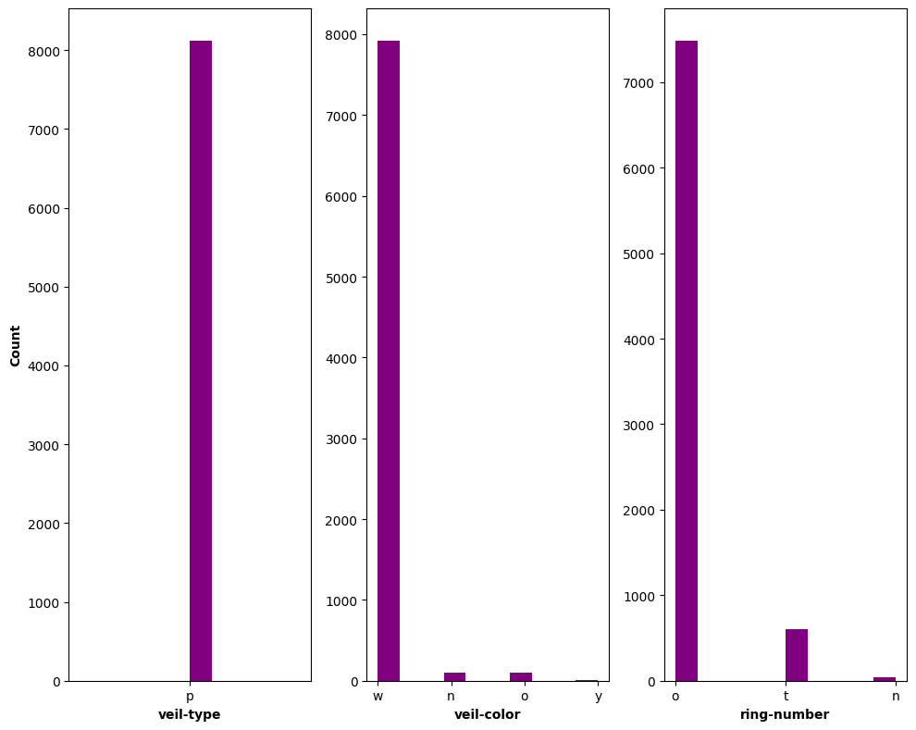
Mushroom’s veil and ring data distribution

Slide 7
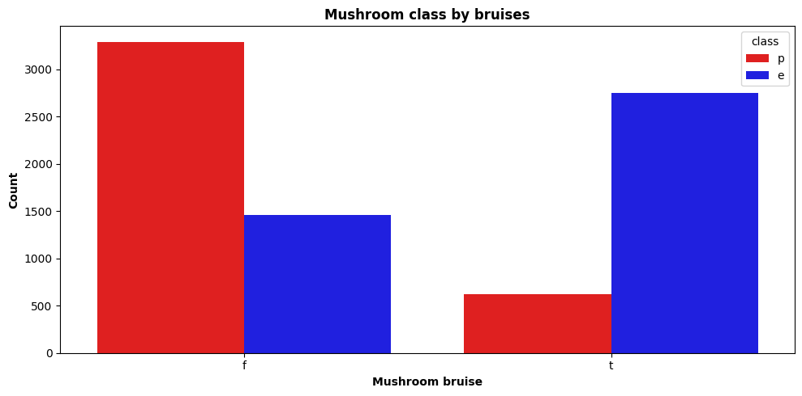
Relation between Mushroom class and bruises

Slide 8
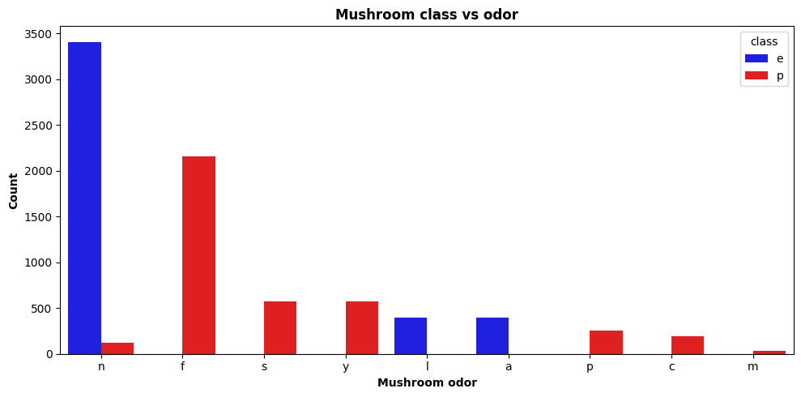
Mushroom class & odor
Code | Odor | Description
A | Almond | Sweet, nutty almond-like smell (often edible)
L | Anise | Licorice-like smell (pleasant; edible)
C | Creosote | Tar or chemical-like odor (often poisonous)
Y | Fishy | Smells like fish (often poisonous)
F | Foul | Rotten or sewage-like smell (strongly poisonous)
M | Musty | Moldy or damp basement smell (may be poisonous)
N | None | No noticeable odor (can be edible or poisonous)
P | Pungent | Strong, irritating smell (usually poisonous)
S | Spicy | Sharp or tangy smell (can be edible or not)

Slide 9
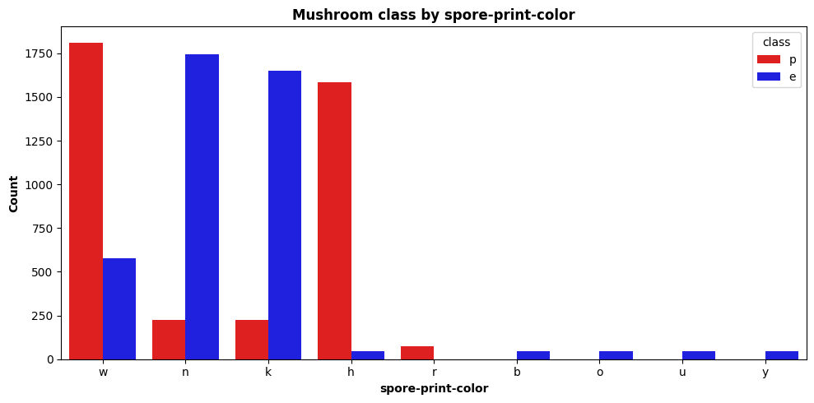
Mushroom class & spore-print-colour
Code | Color
k | Black
n | Brown
b | Buff (light brown)
h | Chocolate
r | Green
o | Orange
u | Purple
w | White
y | Yellow

Slide 10
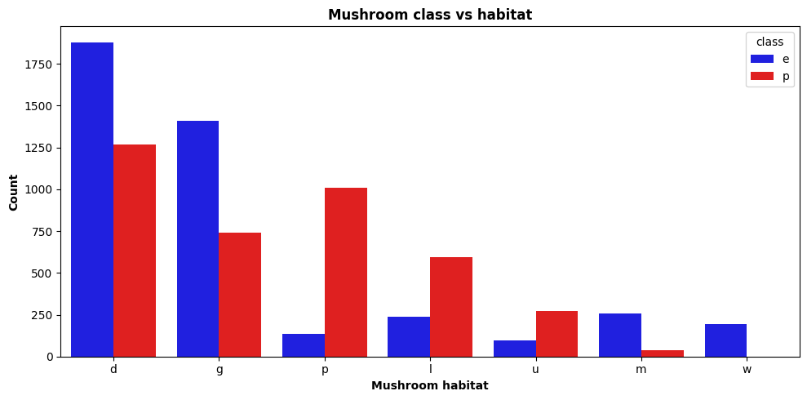
Mushroom class & habitat
Code | Habitat Type | Description
g | Grasses | Open grassy areas like fields or lawns.
l | Leaves | Leaf litter on forest floors — common in wooded regions.
m | Meadows | Natural open fields, sometimes with wildflowers.
p | Paths | Along trails, walkways, or roadsides.
U | Urban | Near human areas — parks, gardens, etc.
W | Waste | Disturbed areas with decaying organic matter (e.g., compost heaps, trash areas).
D | Woods | Deep or dense forests with trees and shade.

Slide 11
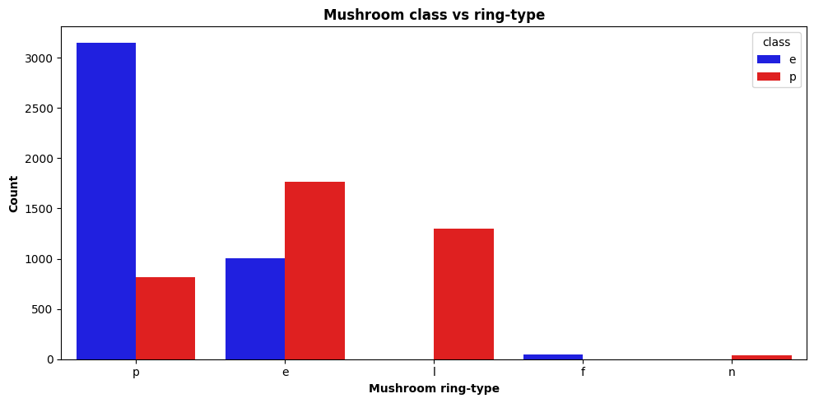
Mushroom class & ring-type
Code | Ring Type | Description
E | Evanescent | Very fragile, often disappears quickly after the mushroom matures.
F | Flaring | The ring spreads outward like a skirt.
L | Large | Thick and prominent ring.
N | None | No ring at all.
P | Pendant | Hanging down from the stalk like a curtain.

Slide 12
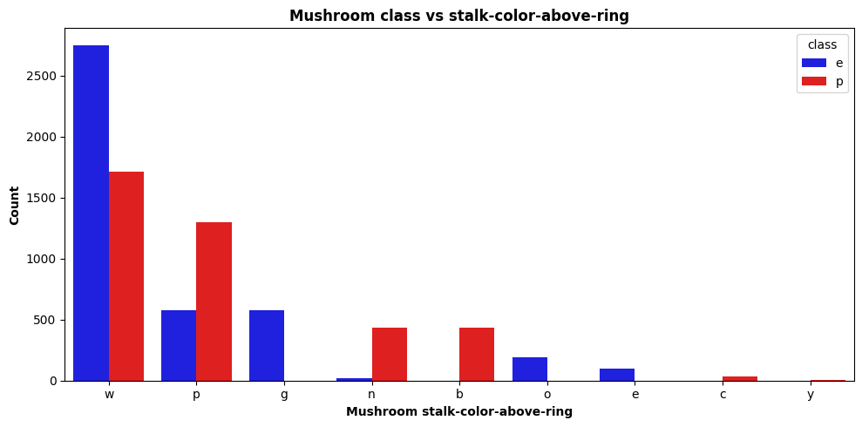


Slide 13
Data preprocessing
No missing values
Column ‘stalk-root’ has 2480 ( ~ 30%) ‘?’ missing/unknown value – replaced it with mode for this column.
Modify target column ‘class’ to 0- edible, 1-poisonous from e-edible, p-poisonous by LabelEncoder
22 features – all categorical – used OneHotEncoder – resulting into 117 columns
Didn’t use any scaler as all the values are either zero and one.
Split the data into training and testing (20%) data

Slide 14
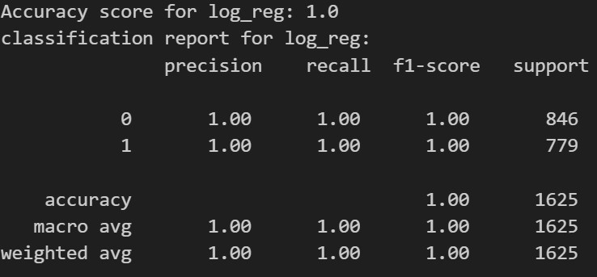
Logistic regression model
K-Fold Cross Validation scores: [1. 0.99938462 1. 1. 1. ] Mean accuracy: 0.9998769230769231

Slide 15
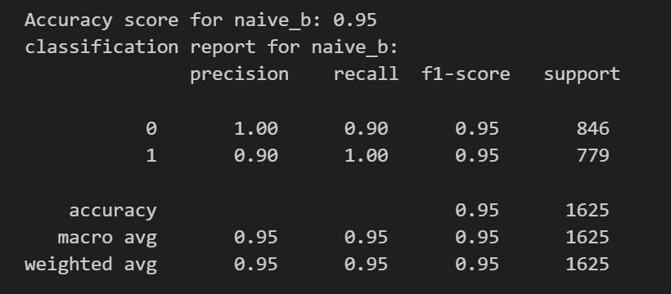
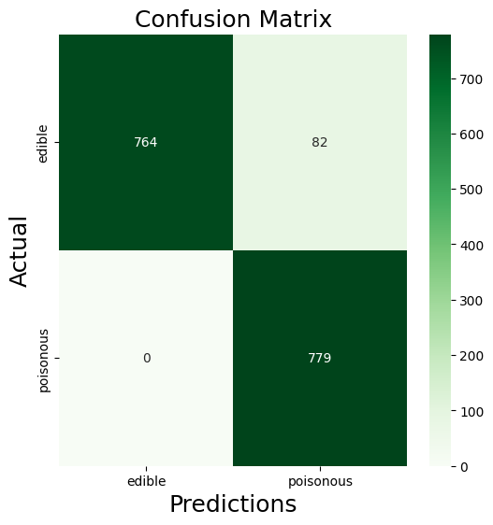
Naive Bayes Model

Slide 16
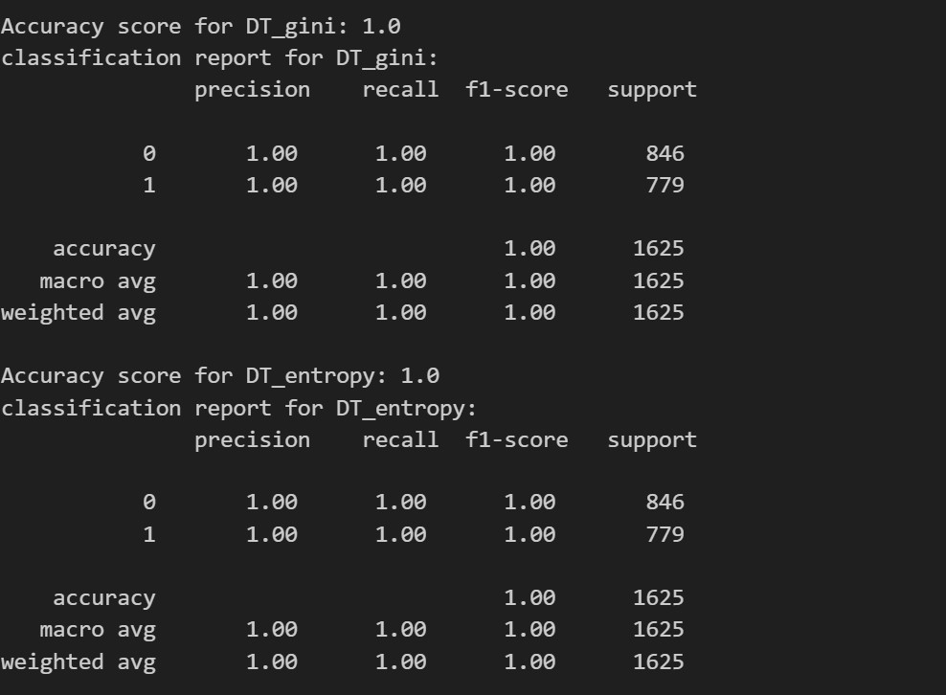
Decision Tree Models

Slide 17
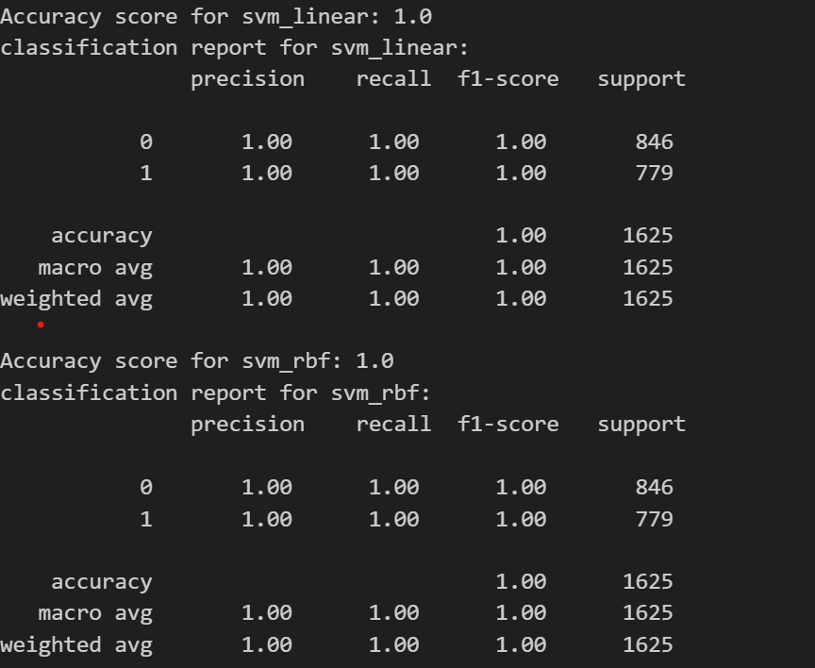
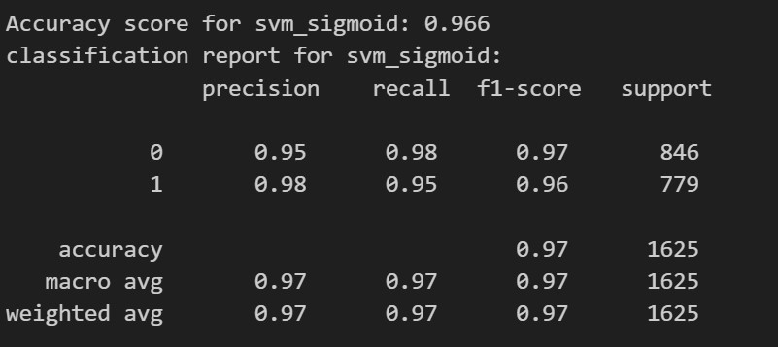
Support Vector Machine Models

Slide 18
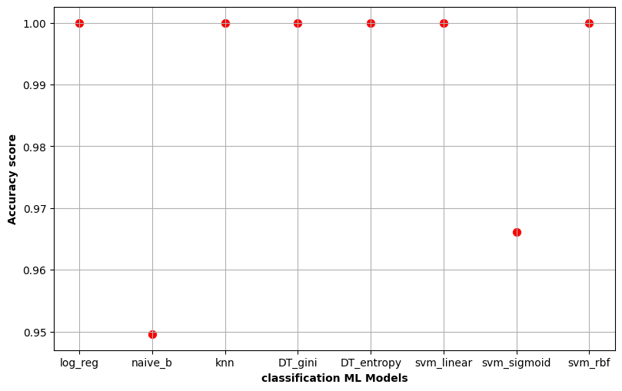
Comparison among different models

Slide 19
Conclusion
All features have good predictive power
Model performance is really good
Correlated features present- Niave bayes model performance was lower
Low svm_sigmoid performance indicating linear relationship between features and target
Still have scope to check model performance after replacing ‘stalk-root’ column ‘?’ with real data and see how it affects the prediction

